Slide 1
Twitter Stock Market Sentiment Analysis
Duan Lin
CS688 Web Analytics and Mining
May 5, 2020

Slide 2

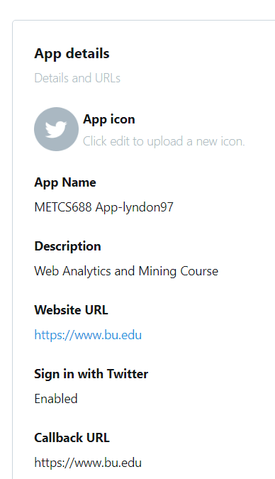
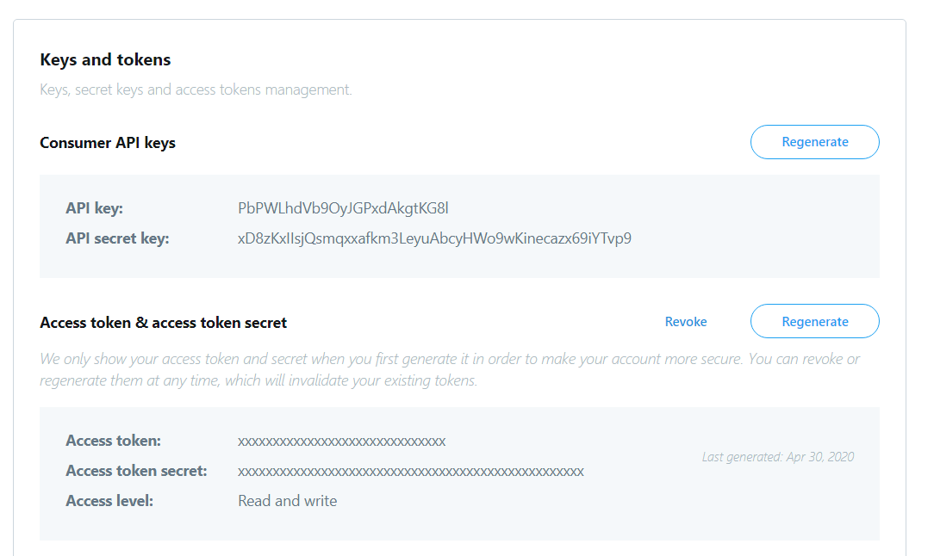
Registering my Application with Twitter
My API key & secret key

Slide 3
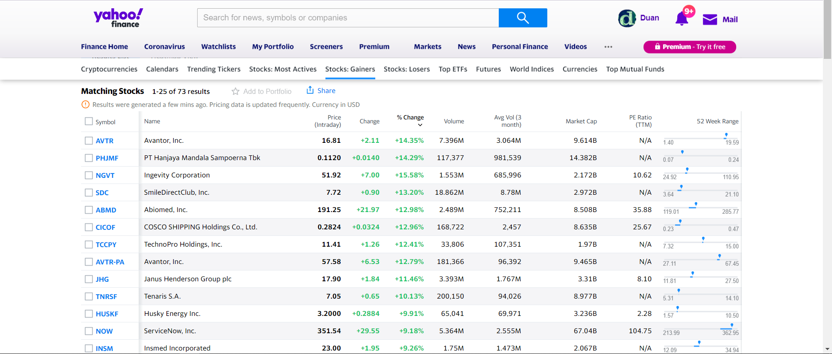
Select 3 Top Gainers and Losers (via Yahoo Finance)
Top gainers:
AVTR, SDC, NGVT
Top losers:
OLN, MANT, GIL

Slide 4
Main Process Steps
Search for 100 tweets for each top gainers and losers (like $AVTR)
Combine 3 top gainers / losers into a whole tweet and create corpus.
Preprocessing: remove whitespace & numberwords etc. in content
Make Term Document Matrix for these 6 stocks, and compute each frequent terms then display as WordCloud.
Compute sentiment score based on “positive-words.txt” and “negative-words.txt”.
Plot the bar chart of sentiment score, and use “googleVis” package to draw candlestick chart of the stock.

Slide 5
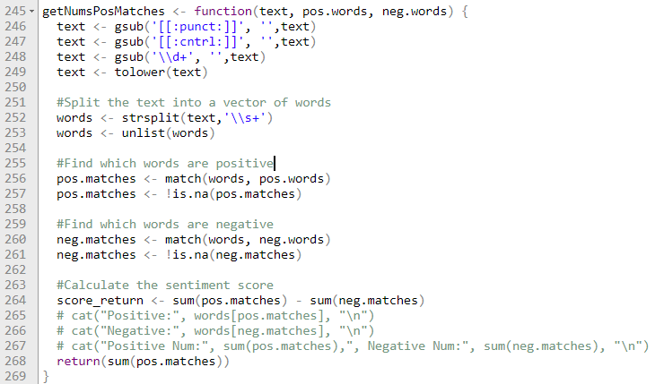
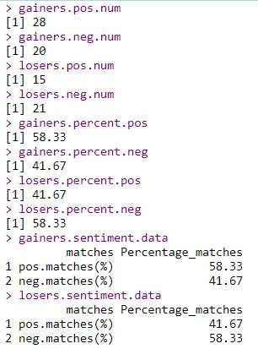
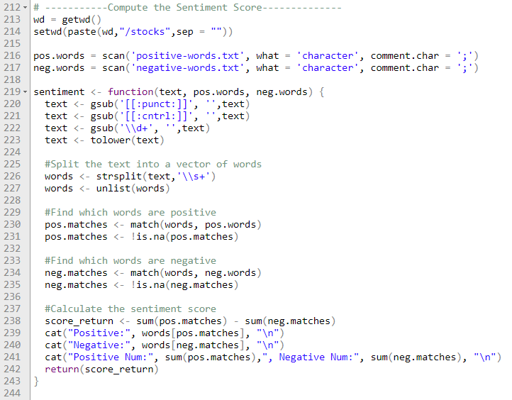
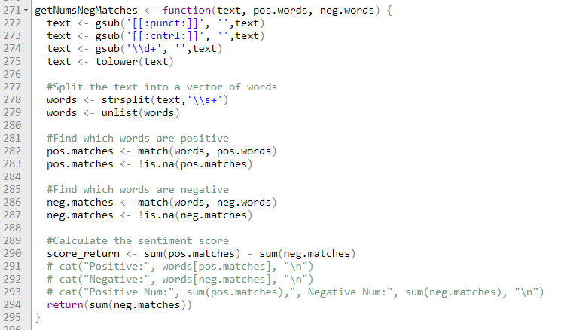
Sentiment Score Codes
Calculate Numbers of positive matches
Final results
Calculate sentiment score
Calculate Numbers of negative matches

Slide 6
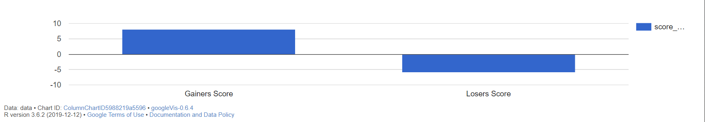
Graph 1: Sentiment Score of Gainer and Loser (up till 5/1/2020)
Gainers Score: 8 (pos.matches = 28, neg.matches = 20)
Losers Score: -6 (pos.matches = 15, neg.matches = 21)

Slide 7
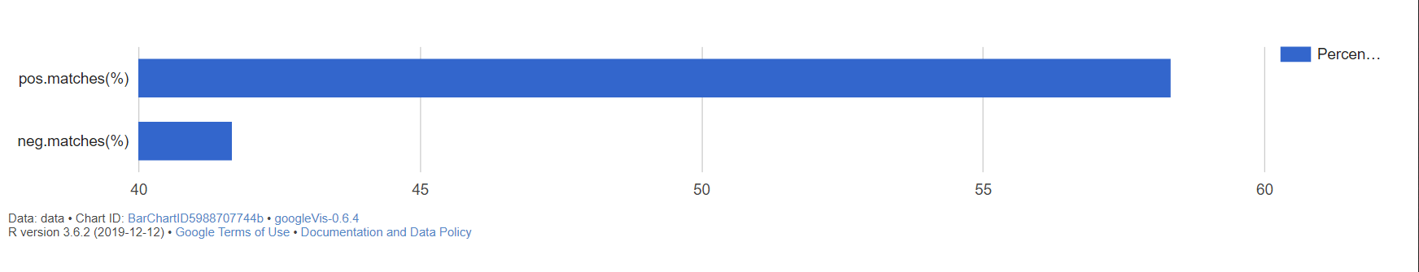
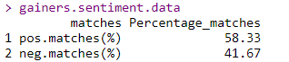
Graph 2: Percentage of Positive and Negative Matches in Gainers (up till 5/1/2020)

Slide 8
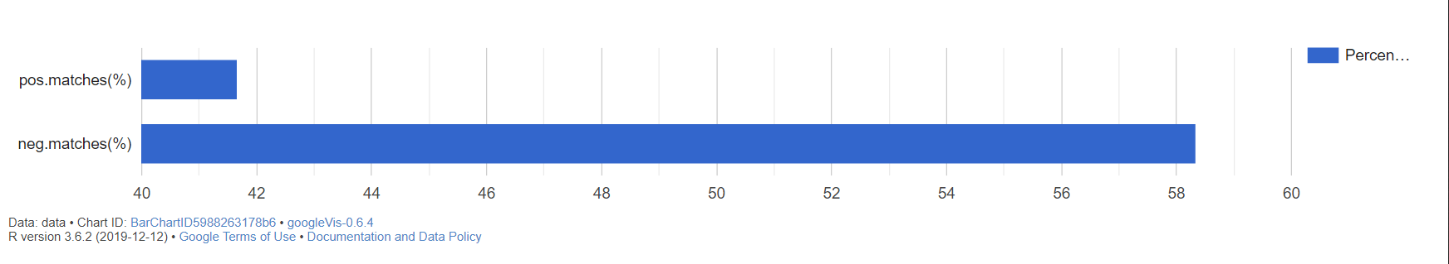

Graph 3: Percentage of Positive and Negative Matches in Losers (up till 5/1/2020)

Slide 9
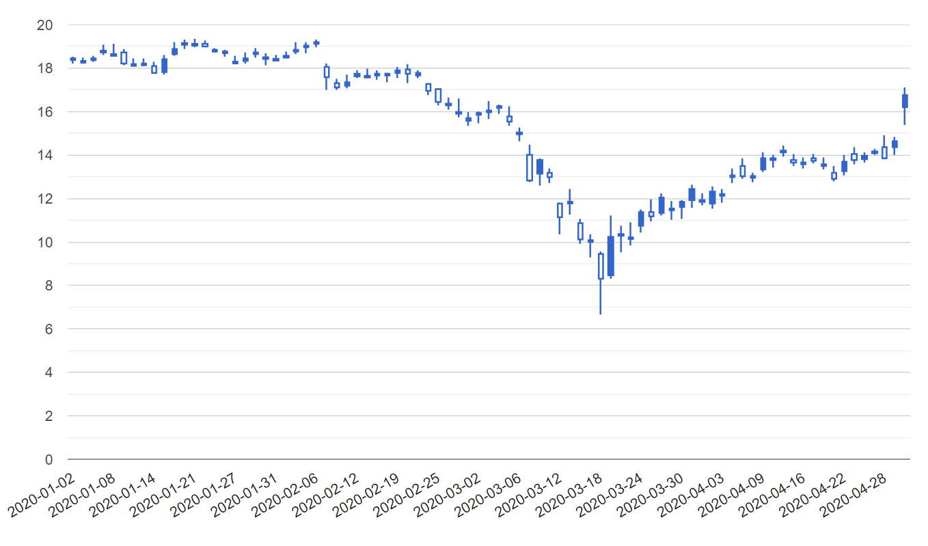
Graph 4: Candlestick Graph of stock “AVTR” plotted by googleVis (up till 5/1/2020)
From
1/2/2020
To
5/1/2020

Slide 10
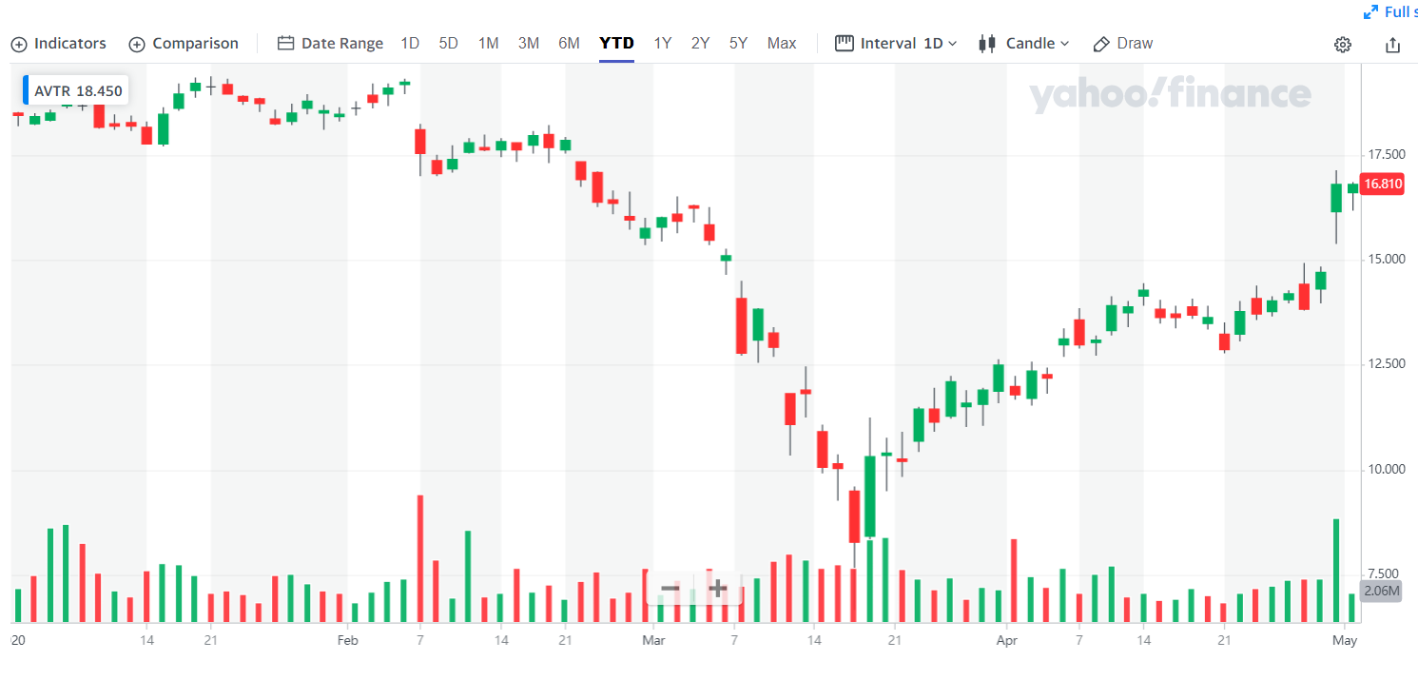
Candlestick Graph for Comparison
My plot
From Yahoo Finance
Verify that they are the same!!

Slide 11
My Conclusion
Consequently, I found that gainers has positive sentiment score (score=8), while losers has negative score (score=-6), which means the tweets contents related to those gainers has more positive words so people may be optimistic about them. In contrast, losers stocks has been proved that they gained more unpromising or negative views by people.
In short, according to the result of sentiment score and detailed analysis given above, we conclude that the outcomes of sentiment analysis in Twitter stock market conform to the expected perspective that gainers stocks reveal positive score while losers stocks reveal negative score.

Slide 12
Stock Data Reference
Yahoo Finance:
https://finance.yahoo.com/quote/AVTR/history?p=AVTR

Slide 13
THANKS!

